Slide 1
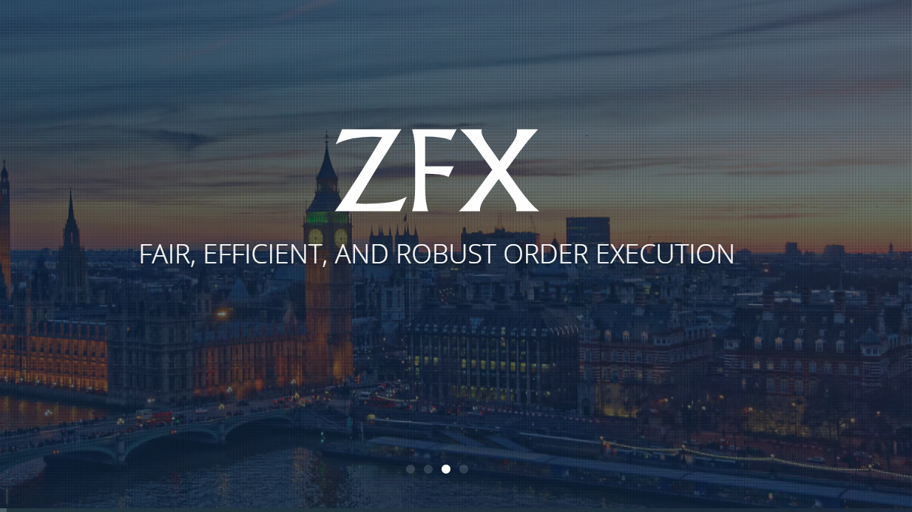
Zeal Group (ZFX)
New Staff Induction Program

Slide 2
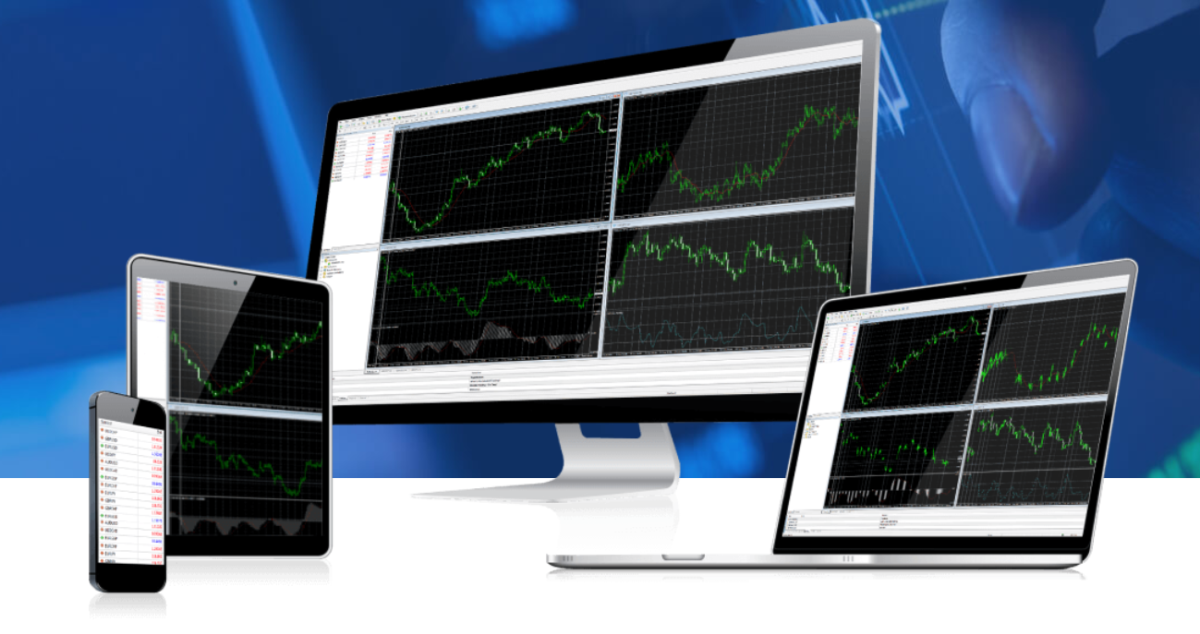
About Us
Zeal group of companies (collectively Zeal Group) is a business portfolio comprising regulated financial institutions (trading as ZFX) and fintech companies.
Specializing in multi-asset trading services including:
Forex (FX, Foreign Exchange or Currency Trading)
Commodities (Gold & Crude Oil)
Indices (CFDs on Major Global Indices)
Shares (Share CFDs)
Over 100,00 of Individual and Introducing Broker (IB) clients
Monthly Trading Volume $30 Billion US Dollars

Slide 3
History
Zeal group of companies (collectively Zeal Group) is the parent company Zeal Holdings Limited
Established in United Kingdom (UK) since 2017
Founded by a group of veteran traders
Specializing in multi-asset liquidity solutions
Backed by proprietary technology
Zeal Holdings Limited and its wholly owned subsidiary:
Zeal Capital Market (Seychelles) Limited
Zeal Capital Market (UK) Limited

Slide 4
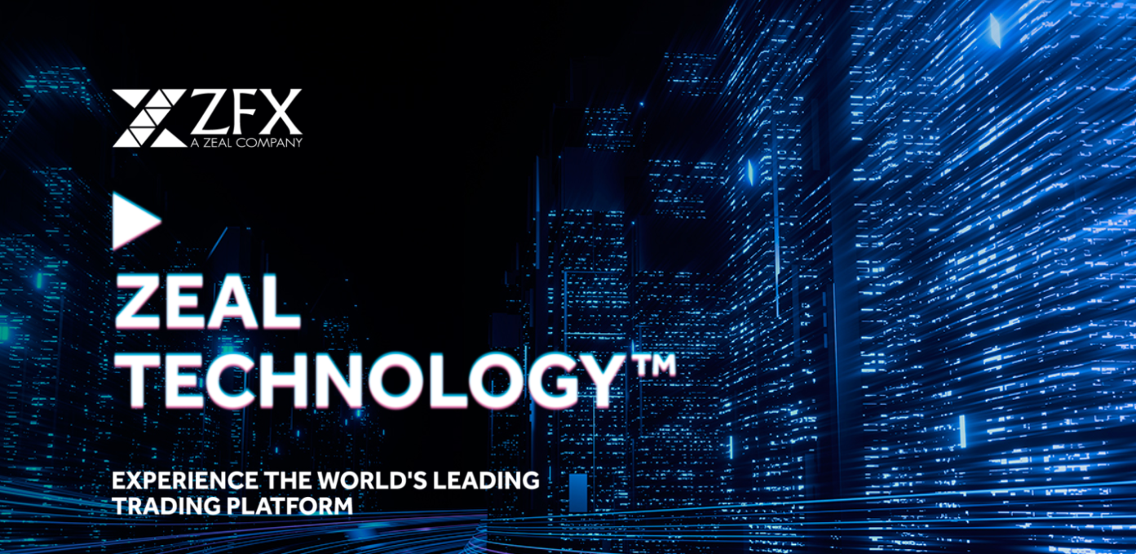
Advantage
Zeal Capital Market (Seychelles) Limited
Regulated as a Securities Dealer by the Financial Services Authority of Seychelles
License number: SD027
Official website: www.zfx.com
Zeal Capital Market (UK) Limited
Authorized and regulated by the Financial Conduct Authority FRN: 768451
A company registered in England and Wales with register number: 10219924
Official website: www.zfx.co.uk
Security of funds
Corporate Governance
Market Neutral Agency Model

Slide 5
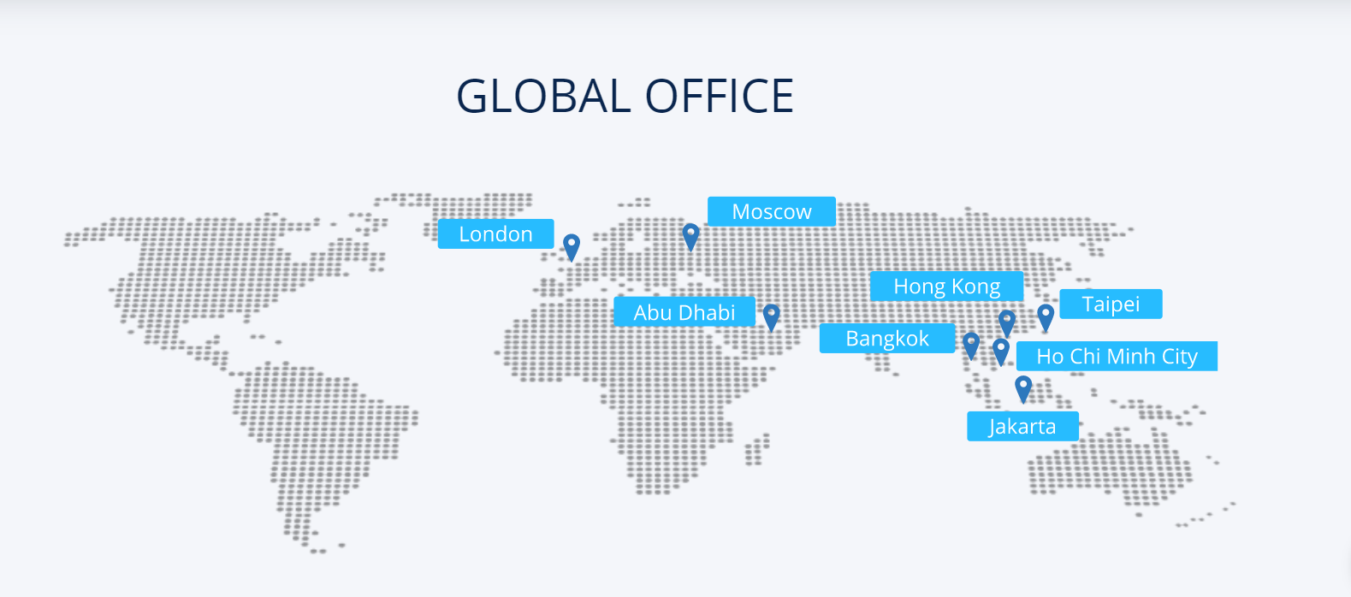
450+
20+
200+
Offices
Countries

Slide 6
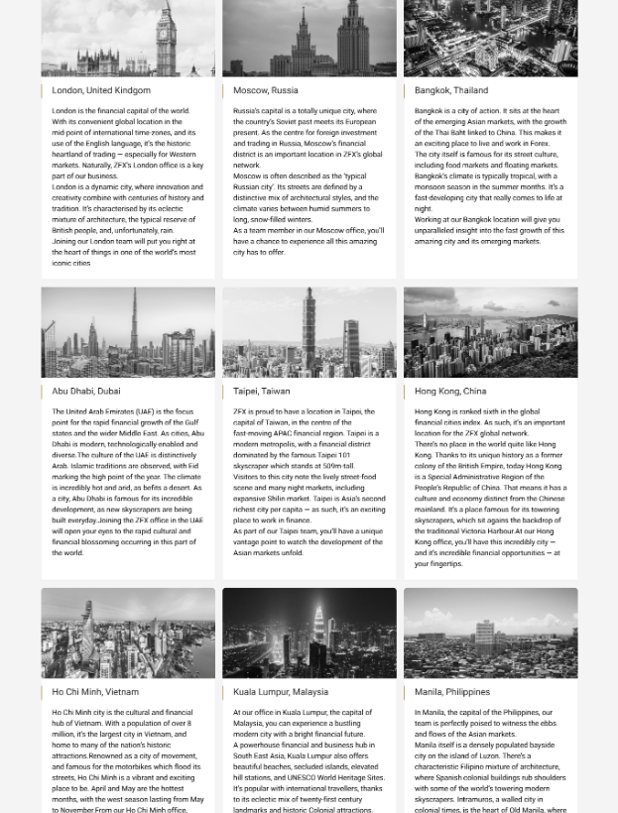
Europe
United Kingdom – Headquarter
Russia
Ukraine
Asia
Hong Kong – Hub of Asia Pacific
Indonesia
Thailand
Vietnam
Taiwan
Malaysia
Middle East
Egypt
Greece

Slide 7
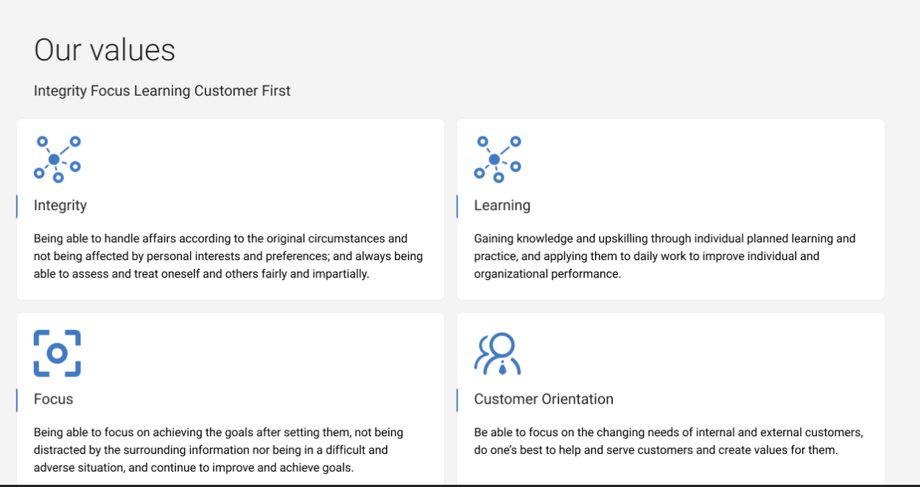

Slide 8
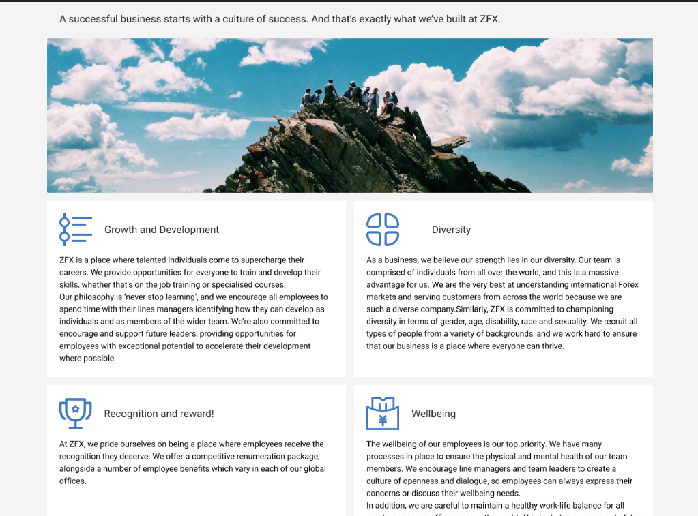

Slide 9
Thank you
For Your Time
Have A Wonderful Journey in Zeal

